Slide 1
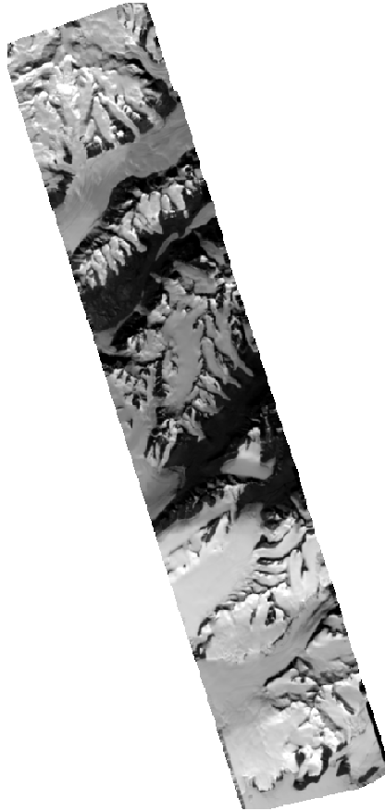
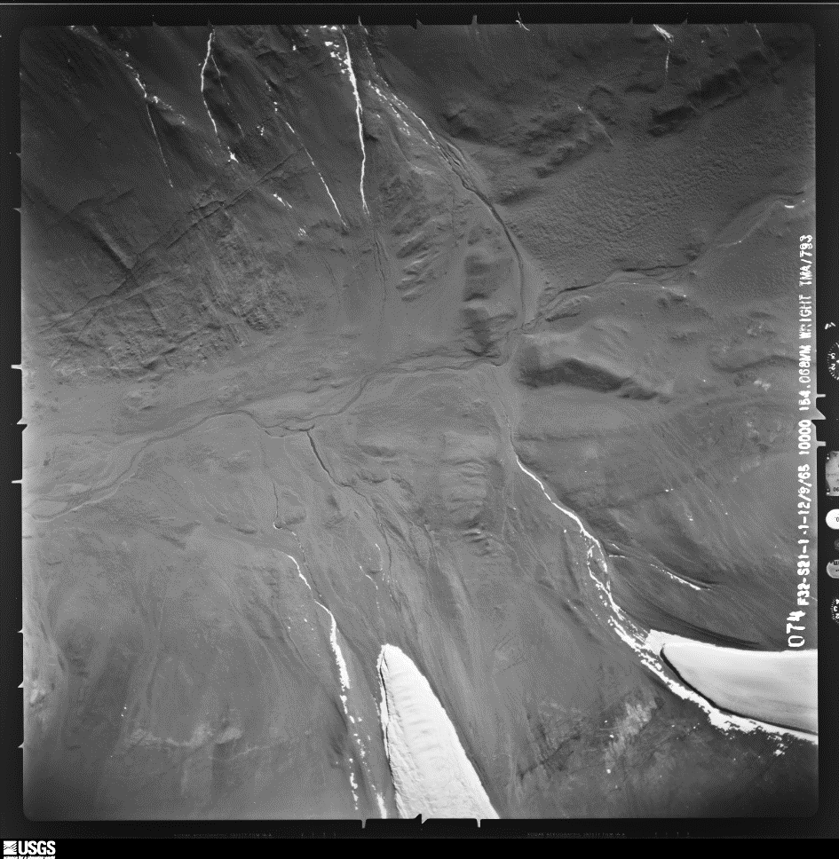
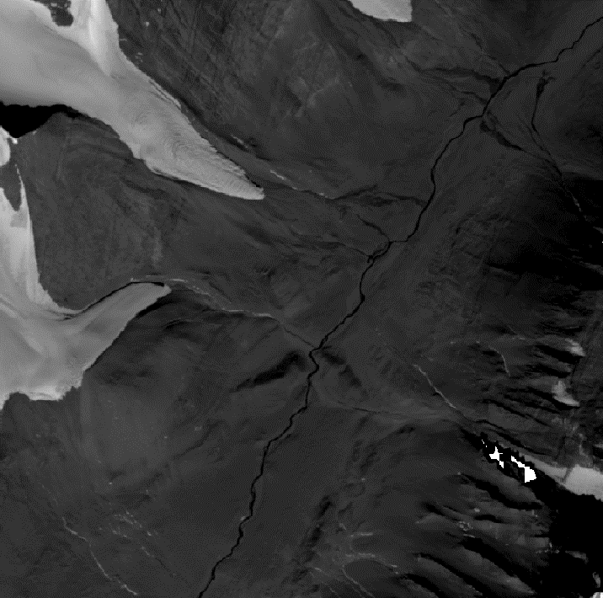
ASIFT: Affine Invariant Image Comparison
2016 WorldView-1 Satellite Strip
1965 USGS Air Photo non-geolocated
Auto-locate matching keypoints,
geo-locate historical airborne image

